Slide 1
Fault Tolerance
Design Considerations
Notes:
Fault tolerance is essential for ensuring the resilience and reliability of messaging systems, allowing them to continue functioning smoothly even when some components fail. Designing for fault tolerance involves implementing redundancy, disaster recovery plans, and techniques to handle partial failures. By incorporating these strategies, we can build system that can recover gracefully from failures, maintain continuous operation, and ensure data integrity. In this section, we will explore key approaches to ahieve fault tolerance, including redundancy, disaster recovery, graceful degradation, and monitoring.

Slide 2
Designing for Fault Tolerance and Disaster Recovery
Notes:
In messaging systems, designing for fault tolerance and disaster recovery is critical to ensure the system remains resilient and reliable in the face of failures and disasters. Fault tolerance involves building redundancy and failover mechanisms into the system, so it can continue to operate smoothly even when some components fail. Disaster recovery focusses on preparing for major incidents by implementing strategies to back up data, recover quickly, and minimize downtime. By incorporating these approaches, we can build robust messaging systems that maintain continuous operation, protect data integrity, and recover swiftly from unexpected events.

Slide 3

Biggest Outage in Years
Notes:
The CrowdStrike outage on July 19, 2024, was a significant event that caused widespread distribution. A faulty update to CrowdStrike’s Falcon Sensor security software led to 8.5 million systems crashing worldwide, including those of many Fortune 1000 companies. The outage lasted several days and resulted in estimated losses of over $5 billion.

Slide 4

Biggest Outage in Years
Notes:
Delta Air Lines was one of the companies severely affect ted by this outage. The disruption led to the cancellation of 7,000 flights over five days, impacting 1.3 million customers. Delta estimated its losses at $550 million, including $380 million in revenue and $170 million in operational recovery expenses. The airline also faced additional costs for customer refunds and compensation.
Delta has since filed a lawsuit against CrowdStrike, claiming that the outage was due to untested updates and demanding compensation for the significant disruption it caused.

Slide 5
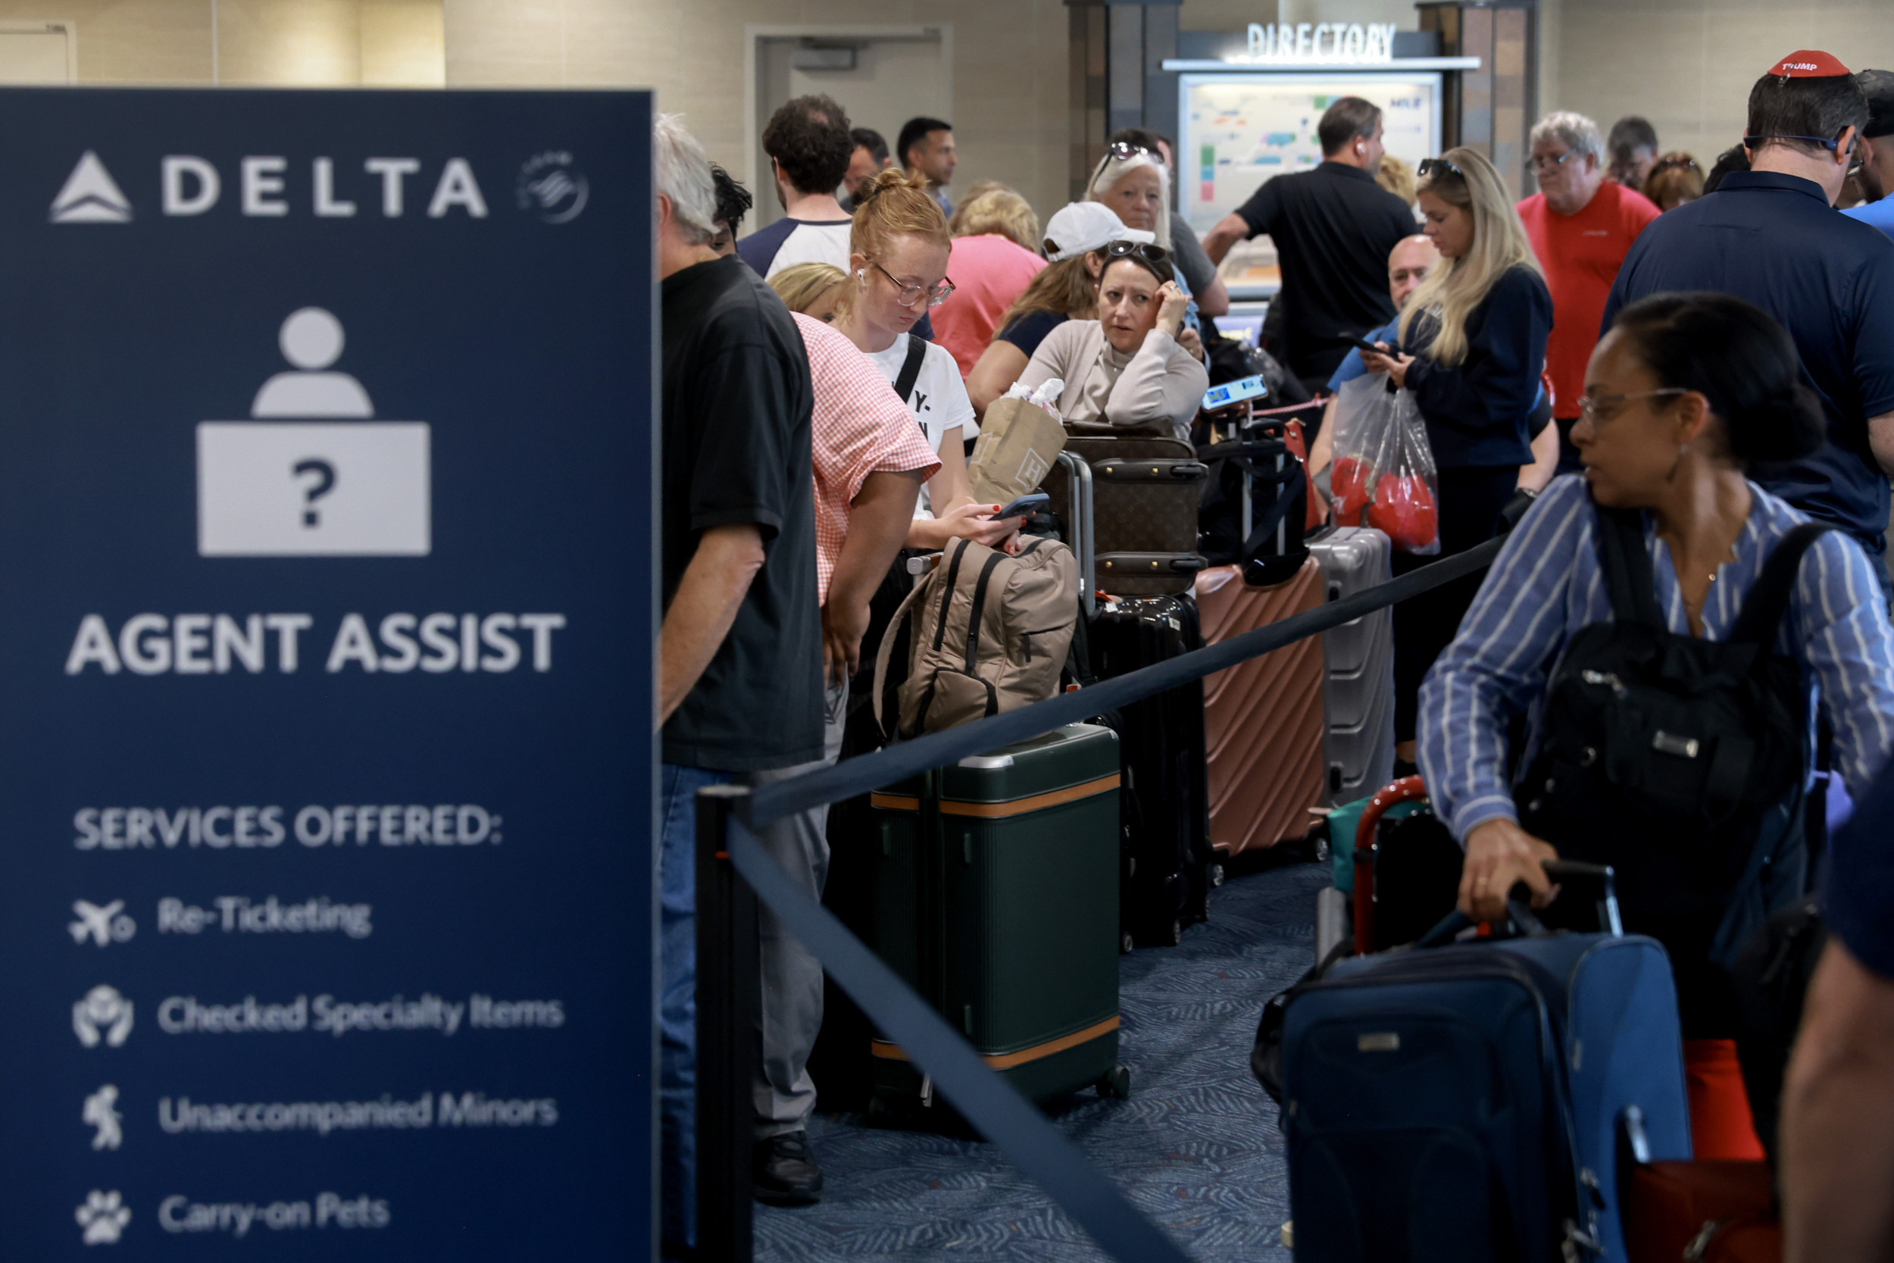
Delta’s Issues
Single Point of Failure
Lack of Redundancy
Slow Recovery Process
Communication Challenges
Operational Distruption
Notes:
Delta faced significant challenges with their fault tolerance and disaster recovery during the outage. Here are some key points:
Single Point of Failure: Delta’s systems were heavily reliant on CrowdStrike’s Falcon Sensor software. When the faulty update caused the software to crash, it created a single point of failure that affected the entire operation.
Lack of Redundancy: Delta’s IT infrastructure lacked sufficient redundancy to handle such a widespread outage. This meant that when the primary system failed, there were no backup systems in place to take over seamlessly.
Slow Recovery Process: The recovery process was slow and cumbersome. Delta had to manually reposition flight crews and aircraft, which took several days. This was exacerbated by the high volume of traffic on their online tools, causing intermittent performance issues.
Communication Challenges: Delta struggled to communicate effectively with customers during the outage. Their online tools and social media platforms were overwhelmed, leading to delays and providing timely updates and rebooking options.
Operational Disruption: The lack of a robust disaster recovery plan led to significant operational distribution. Delta had to cancel thousands of flights, causing major inconvenience to passengers and resulting in substantial financial losses.
Delta has since committed to improving their fault tolerance and disaster recovery processes to prevent such extensive disruptions in the future. They are investing in more robust backup systems and enhancing their communication protocols to better handle unexpected outages.

Slide 6

Redundancy
Designing for Fault Tolerance and Disaster Recovery
Replication
Failover Mechanisms
Notes:
Implement redundancy to ensure that there are backup components available in case of failures.
Techniques
Replication: Replicate messages and components across multiple nodes or data centers to ensure availability and continuity.
Failover Mechanisms: Set up failover mechanisms to automatically switch to backup components in case of failures.
Benefits
Enhances system resilience and ensures continuous operation even in the event of failure.

Slide 7

Disaster Recovery
Designing for Fault Tolerance and Disaster Recovery
Data Backups
Recovery Plans
Notes:
Plan and implement strategies for recovering from major failures and disasters.
Techniques
Data Backups: Regularly back up data and messages to secure, off-site locations.
Recovery Plans: Develop and test disaster recovery plans to ensure a swift and organized response to major incidents.
Benefits
Minimizes downtime and data loss, ensuring quick recovery from disasters.

Slide 8
Techniques for Handling Partial Failures
Notes:
In distributed messaging systems, it is crucial to design for scenarios where some components may fail while other continues to operate. Handling partial failures effectively ensures that the system can maintain service continuity and degrade gracefully, rather than experience complete outages. Techniques such as graceful degradation, service isolation, and implementing retry and timeout policies help manage these partial failures, allowing the system to recover and continue functioning with minimal disruption.

Slide 9

Graceful Degradation
Techniques for Handling Partial Failures
Service Isolation
Fallback Strategies
Notes:
Design the system to continue functioning, albeit with reduced capacity, when some components fail.
Techniques
Service Isolation: Isolate failing components to prevent them from affecting the entire system.
Fallback Strategies: Implement fallback strategies to handle requests when primary services are unavailable.
Benefits
Ensures that the system remains operational even when some components fail, maintaining service continuity.

Slide 10

Retry and Timeout Policies
Techniques for Handling Partial Failures
Retry Logic
Timeouts
Notes:
Implement retry and timeout policies to handle transient failures and ensure timely recovery.
Techniques
Retry Logic: Automatically retry failed operations after a short delay to recover from temporary issues.
Timeouts: Set timeouts for operations to prevent them from hanging indefinitely and to trigger retries or alternative actions.
Benefits
Improves system resilience by handling transient failures and ensuring timely recovery.

Slide 11
Strategies for Ensuring System Resilience
Notes:
Ensuring system resilience is vital for maintaining the reliability and stability of messaging systems, especially under varying loads and unexpected failures. By implementing continuous monitoring, effective alerting, and load balancing, we can proactively manage system health and quickly respond to any issues. Additionally, strategies like dynamic scaling and distributing load evenly across multiple instances help maintain consistent performance and prevent overloading. These resilience strategies are essential for building robust messaging systems that can adapt and thrive in diverse operational environments.

Slide 12

Monitoring and Alerting
Techniques for Handling Partial Failures
Health Checks
Automated Alerts
Notes:
Continuously monitor the system and set up alerts to detect and respond to failures promptly.
Techniques
Health Checks: Implement regular health checks for components to ensure they are functioning correctly.
Automated Alerts: Set up automated alerts to notify administrators of any issues or anomalies.
Benefits
Ensures proactive management of system health and quick response to failures.

Slide 13
Load Balancing and Scaling
Techniques for Handling Partial Failures
Dynamic Scaling
Load Distribution
Notes:
Use load balancing and auto-scaling to distribute load evenly and handle varying traffic.
Techniques
Dynamic Scaling: Automatically scale resources up or down based on current load to handle traffic spikes and reduce costs.
Load Distribution: Distribute load evenly across multiple instances to prevent overloading any single component.
Benefits
Enhances system resilience and ensures consistent performance under varying loads.

Slide 14
Recap: Fault Tolerance
Redundancy and Disaster Recovery
Handling Partial Failures
System Resilience
Notes:
Redundancy and Disaster Recovery: Implement redundancy and plan for disaster recovery to ensure system resilience.
Handling Partial Failures: Use graceful degradation, retry, and timeout policies to handle partial failures.
System Resilience: Monitor the system continuously and use load balancing and scaling to maintain resilience.

